Slide 1
Ratio and Proportion
Melissa Hayles

Slide 2
What is a ratio?
A ratio is the comparison of two quantities with the same unit.
A ratio can be written in three ways:
As a quotient (fraction in simplest form)- a/b
As two numbers separated by a colon (:)- a:b
As two numbers separated by the word “to”- a to b

Slide 3
What is a proportion?
A proportion is the equality of two ratios or rates.
If a/b and c/d are equal ratios or rates, then a/b = c/d is a proportion.
In any true proportion the cross products are equal:
You must use cross multiplication, which gives ad=cd
To simplify, you find the greatest common factor for both the numerator and the denominator

Slide 4
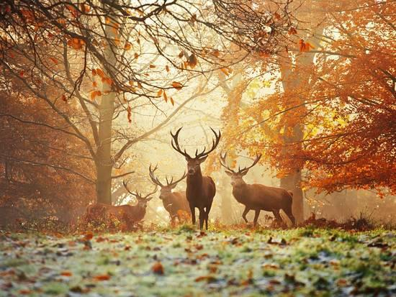
Problem Solving, Ratio and Proportions
Biologist need to find out how many deer are in Newburgh.
Using “tag and recapture” process, estimate the size of a population

Slide 5
Objective
Purpose: Use and manipulate concrete objects that are instructional in formulating and testing their thinking and understanding of ratio and proportion
Goal: To estimate the number of deer in the forest using “tag and recapture” process.
Materials Needed: 1 bag a white pinto beans; 1 bag of red beans; 1 forest (paper sack); and a trap (a small cup).
White beans = tagged deer
Red bean = untagged deer
Paper sack = forest
Trap = spoon

Slide 6
Process
Steps
1. Red beans are the initial population of deer in the forest; White beans are the tagged deer.
2. Using your cage (cup) collect a sample to deer from the forest. Count and tag the deer. Return the tagged deer into the forest.
3. Collect and additional sample. Count the number of tagged and untagged deer.
4. Use the data (counts) to write proportions.
5. Solve the ratios to find the forest proportion.
6. Place the data in the proportion below.

Slide 7
Worksheet
See worksheet
Possible population based on groups

Slide 8

Find the total
$\frac{\text{R}\text{ (}\text{marked} \text{recaptures}\text{)}}{ \text{T}\text{(}\text{total} \text{in} \text{second} \text{sample}\text{)}}$ = $\frac{\text{M}\text{ (}\text{marked} \text{initially}\text{) }}{\text{N}\text{ (}\text{total} \text{pop}\text{. }\text{size}\text{) }}$

